Slide 1
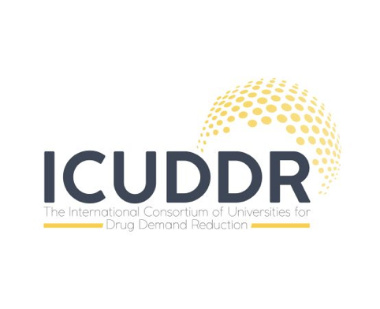
Interprofessional education and collaboration for addiction professionals using team-based and participatory approaches
MASTER CLASS:
Michael Palapal Sy MHPEd OTRP
PhD (Candidate) in Occupational Therapy, Tokyo Metropolitan University (Japan)
Post-graduate Diploma on Drug Studies and Policies from Lisbon University Institute (Portugal)
Adjunct Professor, Angeles University Foundation (Philippines)
Associate Member, Department of Science and Technology - National Research Council of the Philippines
Social Media: @mikesyot
Website: www.mikesyot.com
Cusco, Peru | 07.23.19

Slide 2
Workshop aims
Discuss basic principles of interprofessional education and interprofessional collaboration in the context of the addiction field;
Present a case study depicting a community-based and collaborative project in the Philippines espousing interprofessional collaboration;
Apply the Team-Explain-Agree-Move (TEAM) Protocol for the case study.

Slide 3
Timeline
40
40
40
mins
mins
mins
Informing
Applying
Sharing
Didactics
Case study
TEAM Protocol
Output
Idea exchange

Slide 4

Context

Slide 5
Relevant statistics
Statistics based on residential and out-patient facilities
Most commonly used
Shabu, cannabis, and contact cement (rugby)
Nature of drug using
Mono-drug use
Mean age, sex
31 years; male:female is 10:1
Civil status
Single, 53.5%
Residence
Urban, 43.3% (NCR)
Duration of drug use
6 years and above
  (Dangerous Drug Board, 2017)

Slide 6
Comparative statistics
Determinant | Filipino drug user | General population
Marital status | 46.5% are married | Median age: 29 (male); 27 (female)
Unemployment rate | 46.5% | 5.1%
Reached high school education and beyond | 27.3% | 66.8%
Average monthly income | PhP 12,338 (~56.0%) | PhP 22,000
  (Dangerous Drug Board, 2017; Philippine Statistics Authority, 2016, 2018)

Slide 7
So, what now?
Over 9,000 deaths linked to the campaign, which was dubbed as a failure in Thailand, Mexico and other countries.
Inter-agency efforts have been made possible to reduce casualties. These efforts involve more humane enforcement of the law:
  prevention education;
  collaboration between GOs, NGOs, and Church (socio-civic and faith-based projects);
  drug rehabilitation towards productive individuals for society.
  (Ang 2011; Chapman & Babor 2017; Simangan 2017)

Slide 8
Identified concerns
Illicit substance abuse is a multifaceted social issue rooted from poverty, social deprivation, corruption, and mental health issues which leads to 250,000 deaths per year (UNODC, 2016).
Alcohol and drug use has the most number and varied risk factors leading to disability or deaths. 9th cause of disability-adjusted life year (DALY) in the Philippines (IHME, 2017).
There is a dearth of mental health professionals working in the mental health sectors most especially in drug addiction and rehabilitation settings (WHO, 2014).
The lack of human resources can potentially reflect lack of training and educational opportunities, fragmented practice, and a tendency to lean towards domineering approaches.

Slide 9
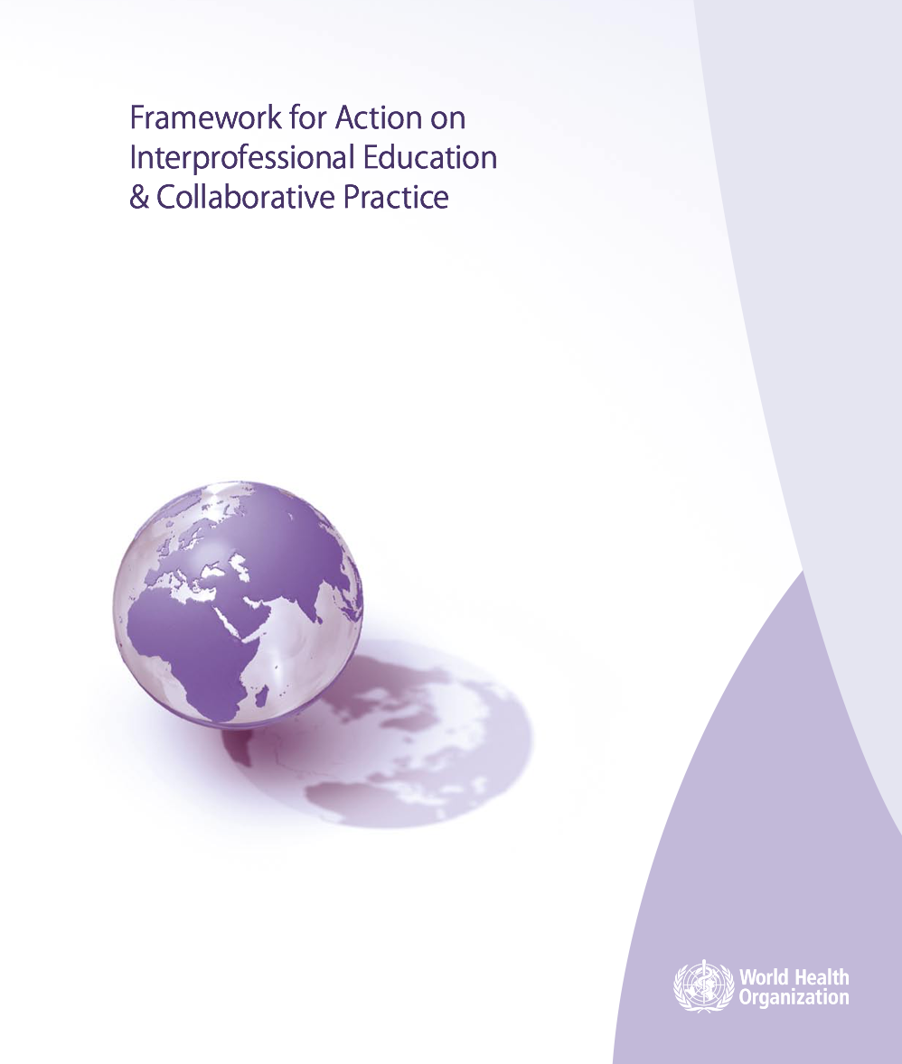
Proposed solutions
Interprofessional Collaboration (IPC) is often able to provide a more comprehensive approach in health and social care delivery to preventing and managing non-communicable diseases and mental health conditions (WHO, 2010) including substance addiction.
Improved health outcomes are the collective end-goal of effective IPC which necessitates Interprofessional Education (IPE), an occurrence when two or more professionals learn about, from, and with each other (WHO, 2010).
Learning strategies drawn from IPE concepts can stimulate constructive discussions of complex issues such as illicit drug using and addictions.

Slide 10
Questions
How are people working in the drug addiction setting trained and educated?
What is the practice trend in addiction care in the Philippines?
Who are the people working in drug addiction rehabilitation?

Slide 11
Addiction studies and training
5 of 10 countries (Philippines not included) in SEA have academic programs on addiction studies from certificate to PhD—still not enough.
In the Philippines, there are addiction-related study programs that can be obtained in 5 tracks:
Continuing development trainings and seminars on drug dependence
Module-based short courses on assessment and management of drug dependence treatment
Graduate diploma in Christian counselling (community-based drug recovery track)
Specialist diploma exclusive for physicians
Generic master’s degree (e.g., counseling)
  (Sy, 2019)
Notes:
IPE and IPC are not highlighted as competencies within these programs; maybe implicitly but not deliberately.

Slide 12
Models of practice
(Kiepek, 2016)
Disease Model
Addiction is a progressive disease
Moral Model
Addiction is a moral weakness or deficit in character
Psychological Model
Addiction is a negative habit; a maladaptive behavior
Social Model
Addiction is developed based on environmental factors
Cultural Model
Addiction depends on cultural norms and history
Critical Model
Addiction as shaped by Western society
Notes:
Disease model: addiction is a progressive disease, not curable but recovery can be maintained through abstinence, loss of control over substance use, uncontrollable cravings

Slide 13

Paradigms
(Kiepek, 2016; Hartnoll & Hedrich, 2015)
Abstinence Paradigm
Harm Reduction Paradigm
12 Steps / Alcoholics Anonymous
Opioid substitution
Overdose prevention
Therapeutic communities
Needle & syringe program
Health promotion
Hazelden Model
Drug consumption rooms
Peer education
Focus of treatment is stop using drugs through rehabilitation and recovery.
Evidence-based treatment approach
Focus of treatment is to facilitate the use of drugs in a safe environment.

Slide 14
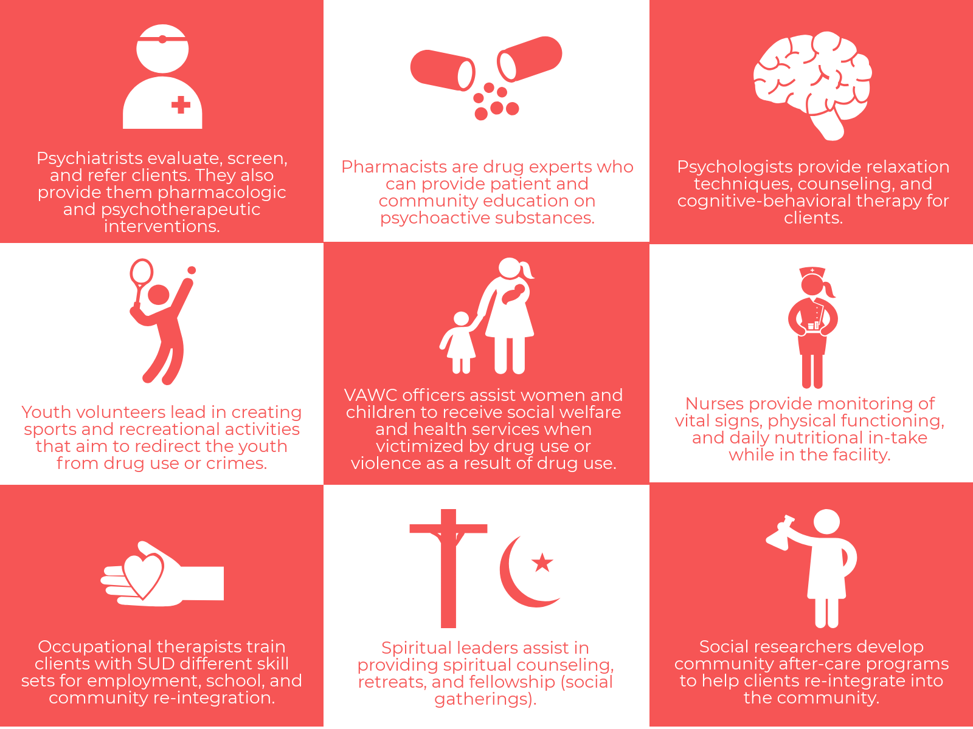
HR for addiction care
What is your role in substance addiction and rehabilitation settings?
n
Professionals
5
Occupational therapists
3
Community workers
2
Psychiatrists
1
Psychologist
Pharmacist
SocSci Researcher
Counselor
n = 14
  (Sy, Ohshima, Roraldo, Pineda, & Lotho 2018)

Slide 15
Community’s voice…
What components do you suggest to be part of a barangay-based SAR program?
Results of content analysis drawn from the focus group discussion
Government accountability
Mentorship between clients and community
Youth-oriented preventive measures
Renaming “drug rehabilitation” as part of destigmatization
Emphasis on employment support
  (Sy, Ohshima, Roraldo, Pineda, & Lotho 2018)

Slide 16
Fragmented ideals and outcomes
Community voices
Residential facilities
Government accountability
Therapeutic community
Emphasis on employment support
Behavioral approaches
Mentorship between client and community
Spiritual approaches
Youth-oriented preventive measures
Functionalist and medical orientation
Renaming “drug rehabilitation as part of destigmatization
Technical skills training
Multidisciplinary approach
Collaboration between and among clients, community, and professionals
(DDB 2013; Sy, Ohshima, Roraldo, Pineda, & Lotho 2018)

Slide 17
Manila Statement on the Drug Problem in the Philippines
(Simbulan, Estacio, Dioquino-Maligaso, Herbosa, Withers, 2019)
…the drug problem in the Philippines is a complex and multi-faceted problem that includes not only criminal justice issues but also public health issues and with various approaches that can be used in order to solve such;
We call for drug control policies and strategies that incorporate evidence-based, socially acceptable, cost-effective, and rights-based approaches that are designed to minimize, if not to eliminate, the adverse health, psychological, social, economic and criminal justice consequences of drug abuse towards the goal of attaining a society that is free from crime and drug and substance abuse…
we call on the Philippine government to address the root causes of the illegal drug problem in the Philippines utilizing the aforementioned affirmations.

Slide 18
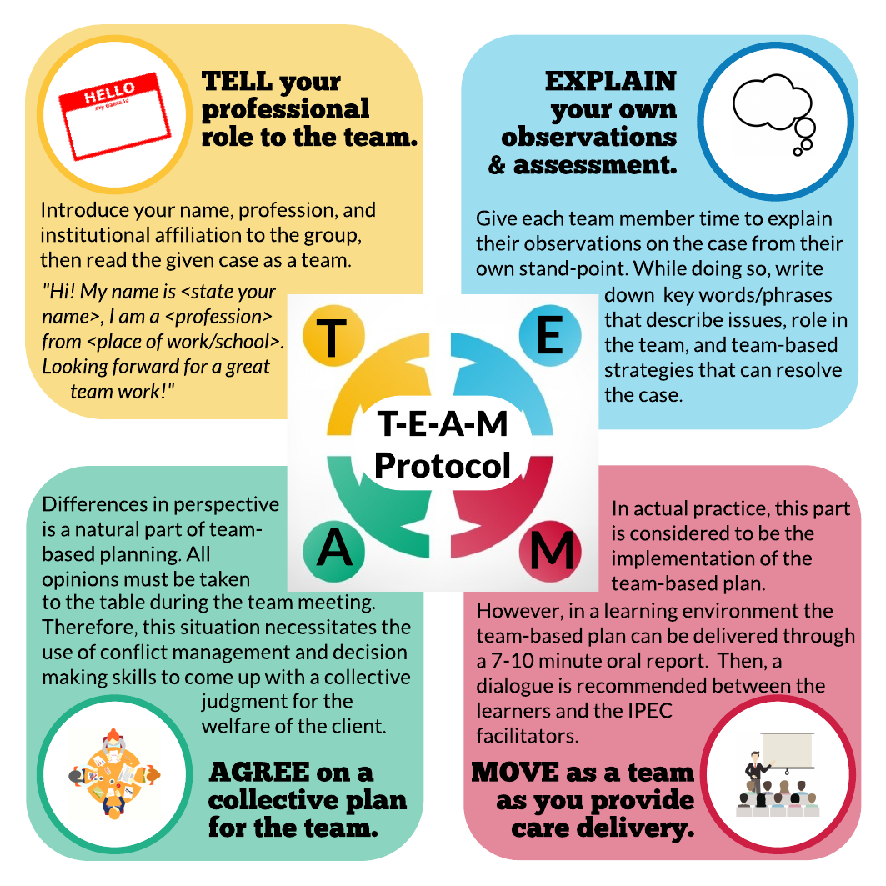
Where do we start?
(Sy, Martinez, & Ohshima, 2017)
Notes:
We start activating the most difficult learning domain to develop: ATTITUDES.

Slide 19

Case Study
Danilo (36/M) residing from an urban-poor community
  Task: Small group discussion
  Process: TEAM Protocol
  Output: 10-minute presentation

Slide 20
Contact
@mikesyot
www.mikesyot.org
THANK
YOU

Slide 21
References
Ang, A. (2011). Drugs & substances abuse. Mandaluyong, Philippines: A1 Publishing.
Chapman, A. R. & Babor, T. F. (2017). Duterte’s War on Drugs and the silence of the addiction science community. Journal of Studies on Alcohol and Drugs, 78(4), 491–493. doi:10.15288/jsad.2017.78.491
Dangerous Drug Board. (2013a). Treatment and rehabilitation. Retrieved from https://www.ddb.gov.ph/legal-services/treatment-and-rehabilitation
Dangerous Drug Board. (2017). Profile of drug users in facilities and cases of admissions in the year 2017. Retrieved from https://www.ddb.gov.ph/research-statistics/statistics/45-research-and-statistics/396-2017-statistics
Hartnoll, R. & Hedrich, D. (2015). Harm reduction policies, settings, and challenges. In N. el-Huebaly, et al. (Eds.), Textbook of addiction treatment: International perspectives, pp. 1315–1335. Italy: Springer-Verlag. doi:10.1007/978-88-470-5322-9_63
Institute of Health Metrics and Evaluation. (2016). Philippines: What risk factors drive the most death and disability combined? Retrieved from http://www.healthdata.org/philippines
Kiepek, N. (2016). Licit, illicit, prescribed: Substance use and occupational therapy. Ottawa, ON: CAOT Publications ACE.
Philippine Statistics Authority. (2018). Employment rate in October 2018 was estimate at 94.9 percent. Retrieved from https://psa.gov.ph/content/employment-rate-october-2018-was-estimated-949-percent
Philippine Statistics Authority. (2016). Average family income in 2015 is estimated at 22 thousand pesos monthly: Results from the 2015 family income and expenditure survey. Retrieved from https://psa.gov.ph/content/average-family-income-2015-estimated-22-thousand-pesos-monthly-results-2015-family-income

Slide 22
References
Simangan, D. (2017). Is the Philippine “War on Drugs” an act of genocide? Journal of Genocide Research, 20(1), 68–89. doi:10.1080/14623528.2017.1379939
Simbulan, N., Estacio, L., Dioquino-Maligaso, C., Herbosa, T., Withers, M. (2019). The Manila Declaration on the Drug Problem in the Philippines. Annals of Global Health, 85(1), 1-4. doi: http://doi.org/10.5334/aogh.28
Sy, M. P. (2019, July). Academic programs on addiction studies in the Philippines. Oral presentation at the 4th ICUDDR Annual Conference, Cusco, Peru.
Sy, M. P., Martinez, P. G. V., Ohshima, N. (2017, August). The status of inteprofessional education and collaboration within occupational therapy, physical therapy, and speech therapy professions in the Philippines. Poster presented at the Association of Medical Education in Europe Conference, Helsinki, Finland.
Sy, M. P., Ohshima, N., Roraldo, M. P. N. R., Pineda, R. C. S. P., & Lotho, D. A. I. L. (2018, September). Maximizing the voices and values of the community in developing a village-based drug recovery program in the Philippines. Oral presentation at the All Together Better Health, Auckland, New Zealand.
United Nations Office on Drugs and Crime. (2012). World Drug Report 2012. Retrieved from https://www.unodc.org/unodc/en/data-and-analysis/WDR-2012.html
World Health Organization. (2010). Framework for action on interprofessional education and collaborative practice. Geneva: World Health Organization. Retrieved from: http://www.who.int/hrh/nursing_midwifery/en/
World Health Organization. (2014). Mental health atlas country profile 2014: Philippines. Retrieved from http://www.who.int/mental_health/evidence/atlas/profiles-2014/phl.pdf?ua=1

